Slide 1
Exploring the Fusion Potentials of Data Visualization and Data Analytics in the Process of Mining Digitalization
Submitted by
K. Akshaya

Slide 2
List of Contents
Abstract
Introduction
Existing system
Proposed system
Advantages
Software Requirements
Hardware Requirements
Conclusion

Slide 3
ABSTRACT
Mining is becoming more digital by using new technologies like sensors, automation, and the Internet of Things (IoT). These tools collect a lot of data, but it's still hard to use that data in the best way. This paper looks at how data visualization (turning data into charts, graphs, etc.) and data analytics (analyzing data to find patterns) can work together to help the mining industry. We review current research on data visualization types, data management, and digital twins (virtual models of real mining systems). We also look at how machine learning can help combine data from different sources. In the end, we talk about the main challenges and what could be done in the future to improve how data is used in mining.

Slide 4
INTRODUCTION
The mining industry is increasingly adopting advanced technologies like IoT, automation, and sensing to collect vast amounts of data. However, effectively utilizing this data to enhance operations remains a challenge. This paper reviews key topics related to the integration of data visualization, management, analytics, and fusion in the mining industry. It explores the role of digital twins, the evolution of data visualization techniques, and the potential of machine learning for data fusion applications. The aim is to highlight the challenges and opportunities of data fusion in mining, drawing insights from recent academic research to promote efficient, data-driven decision-making.

Slide 5
Existing System
The existing system in many mining operations is manual or semi-digital, with limited use of data analytics and basic or no visualization tools. This leads to inefficiencies, delays, and missed opportunities for smarter and safer operations.
Data collection – Sensors and machines collect data but remain siloed.
Basic storage – Data stored in databases, but poorly integrated.
Static reports – Simple dashboards and reports are generated.
Limited analytics – Only descriptive and some diagnostic insights.
Basic visualization – Mostly static charts and graphs, low interactivity.
Manual decisions – Managers interpret data manually for actions.

Slide 6
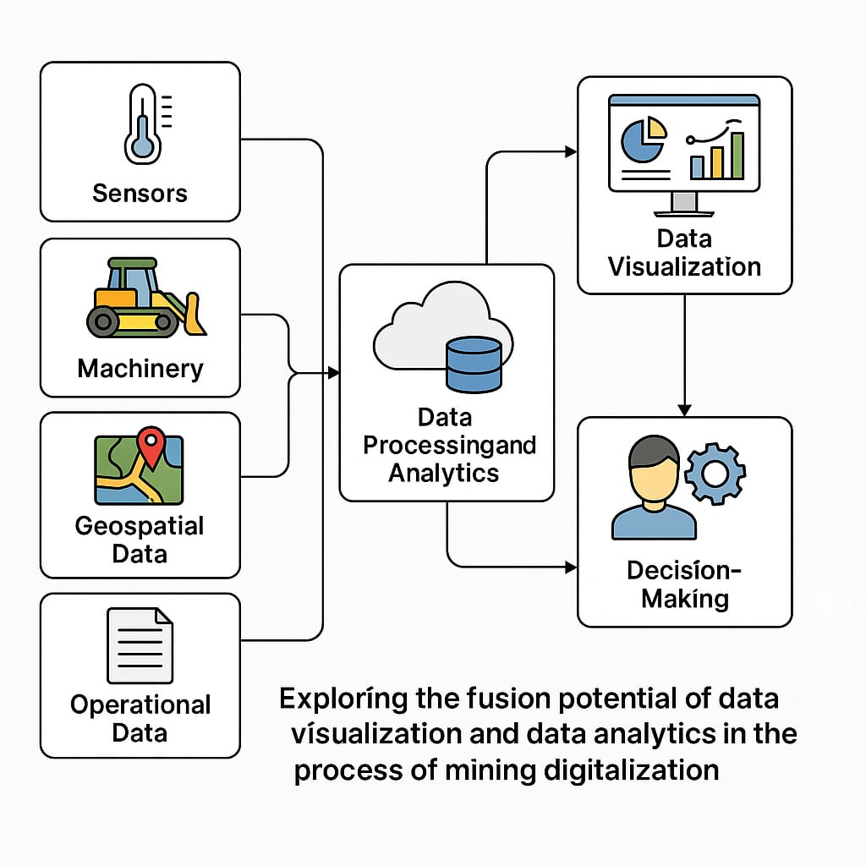
Proposed System
1. Data from sensors and machines is gathered in real-time.
2. The data is processed and analyzed using advanced algorithms.
3. Results are visualized in interactive dashboards.
4. Managers make decisions based on these insights for improved productivity and safety.
This system integrates both data analytics and visualization to create a more efficient, secure, and productive mining operation.

Slide 7
Advantages
1. Faster decisions – Live data helps make quick and smart choices.
2. Better predictions – Know problems before they happen.
3. Clear visuals – Easy-to-understand charts, maps, and dashboards.
4. Saves time and cost – Less manual work, fewer mistakes, better efficiency.
5. Improves safety – Predict risks early and prevent accidents.
6. User-friendly – Even non-technical people can use and understand the system.

Slide 8
Software Requirements
Programming Language: Python
Integrated Development Environment (IDE): Jupyter Notebook
Packages : Pandas , MatplotLib , Numpy , Scikit learn , Tkinter, Seaborn , Plotly, TensorFlow.

Slide 9
Hardware Requirements
System :MINIMUM i3.
Hard Disk :40 GB.
Ram :4 GB

Slide 10
Conclusion
This project helps make mining work better and safer. By putting all the data in one place and showing it in clear charts and maps, managers can see what’s happening in real-time. They can make faster and smarter decisions. The system helps find problems early, improve work, save time, and reduce costs. It also makes mining safer for workers. Overall, mixing data analytics and visualization makes mining easier, smarter, and more efficient.

Slide 11

SOFTWARE REQUIREMENTS:
Operating System: Windows 8
Coding Language: Python 3.7

